Slide 1
Exercise 1
Exercise #1
Modify the cities table in the pandas ipython notebook by adding a new boolean column that is True if and only if both of the following are True:
The city is named after a saint.
The city has an area greater than 50 square miles.
Note: Boolean Series are combined using the bitwise, rather than the traditional boolean, operators. For example, when performing logical and, use & instead of and.
Hint: "San" in Spanish means "saint."

Slide 2
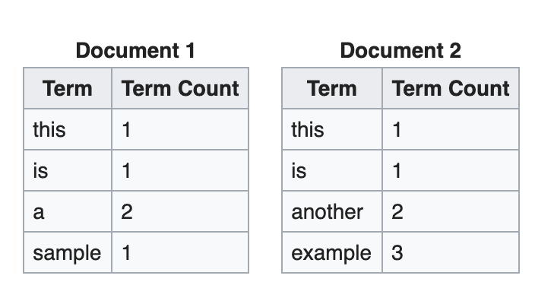
Exercise 2
Create 2 dataframes in pandas based on the information below and calculate tf-idf score for each word in document d1 and d2. The function you try to design is tfidf(w,d) where w can be any word in the vocabulary and d is either d1 and d2.

Slide 3
Exercise 3
Run eigenfaces.py
Change the number of principal components to 200, 250 and 500. Explain the changes you observe in the reconstructed output. As we increase the number of principal components, the reconstructed image looks clearer and sharper as compared to blurry/lossy images seen with lesser principal components. This is because we use all the principal components then you can reconstruct the image without loosing any information
Read the PCA class/function in sklearn and tell the TAs the methods sklearn uses to find the eigenvectors and eigenvalues. Singular Value Decomposition
Fill in the blank: in PCA, given data matrix X of shape n*d where n is the number of data points and d is the dimension of the data, we calculate eigenvectors and eigenvalues of M which is covariance matrix of X.
X is the input matrix with shape n*d where n is the number of data points and d is the dimension of the data. Lets assume Cov(X) = A^{T}A and A = f(X). Find the function f to apply on X that gives you A. Cov(X) is the covariance matrix of X. A = (X - µ)
Why do we sort eigenvalues and select eigenvectors in the decreasing order of eigenvalues. By sorting the eigenvectors in the decreasing order according to their eigenvalues, we sort the principal components by importance order, and eventually remove the ones associated with a small variance.

Slide 4
Exercise 4
Assume we need to create a model that predicts the number of customers at a restaurant at any point of time. What kind of features should we extract?
Restaurant operating hours
Time of day
Menu options (for example, it only serves desserts/drinks or serve main course as well)
Quality/taste of food
Average cost of food
Number of reservations
Ambience

